Slide 1
Why should we care about economic history?
Melissa A. Thomasson Julian Lange Professor of Economics Miami University & NBER

Slide 2
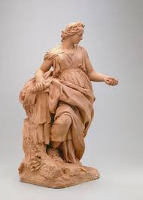

What is economic history?
It is the study of the economic record in history using theory and econometrics
Sometimes called “Cliometrics”
Clio, the
Greek muse of
history
+
metrics

Slide 3
Why does the past have useful information?
It provides us with a deep understanding of the impact of various events and how and why they happen

Slide 4
Economic history lets us answer “big picture questions”
How did we develop as a nation or across nations?
How have different groups experienced development?
What forces bring about differential development?

Slide 5
Calculated using data from: http://www.ggdc.net/maddison/oriindex.htm

Slide 6
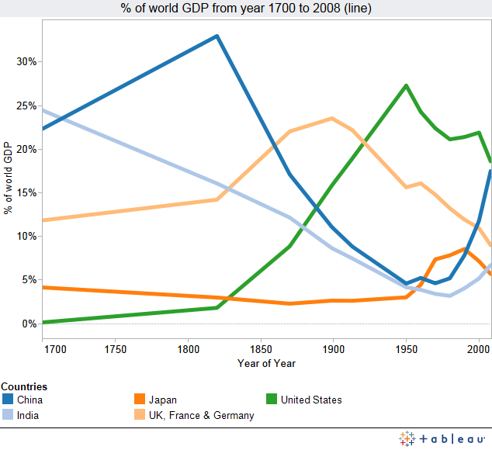
But each nation’s share changes over time

Slide 7
The importance of institutions
Much (but not all) of economic growth and develop is determined by institutions: both political and economic

Slide 8
Political Institutions
Rules created and enforced by the state and citizens that determine the ability of citizens to control politicians and influence how they behave. They include (but are not limited to):
Whether the society is a democracy
Written constitutions
The power and capacity of the state to regulate and govern society
How political power is distributed, and the ability of people to act to pursue their own objectives or to stop others from pursuing theirs. (Acemoglu and Robinson 2014)

Slide 9
Economic Institutions
Set of economic rules (determined by politics and political institutions) that shape economic incentives: to become educated, to save and invest, to innovate, etc. (Acemoglu and Robinson 2014)

Slide 10
Impact of institutions: the rise of the mafia in Sicily
Emerged in 1870s
Has been a serious threat to the rule of law both in Italy and the United States
Murders
Embezzling
Bombings

Slide 11

Lemons don’t always lead to lemonade
Sicily is an important trade crossroads and has bountiful citrus. The discovery that citrus prevented scurvy led to a boom in the global citrus trade that led to the development of the Sicilian mafia, as weak institutions (like policing) led growers to contract with “protectors”.
Parallels Latin American today. Speaks to how institutions affect economic growth, and how agricultural price shocks can result in violence.
-Arcangelo Dimico, Alessia Isopi, Ola Olsson. “Origins of the Sicilian Mafia: The Market for Lemons.” J Econ History, 77(4) December 2017.

Slide 12
Useful laboratory to test economic theory
How much of price changes due to tariffs is passed on to consumers?
“A tariff reduction is immediately passed through to consumer prices with no impact on the export price, whereas about 40 percent of a tariff increase is passed through to consumer prices and 60 percent borne by foreign exporters. The apparent explanation for the asymmetric response is the asymmetric response of demand: imports collapse upon a tariff increase, but do not surge after a tariff reduction.”
--Douglas A. Irwin. “Tariff Incidence: Evidence from US Sugar Duties, 1890-1914” (National Tax Journal 72(3): pp. 599-616).

Slide 13
Economic history provides a better understanding of the world today
“It is sometimes not possible to uncover the logic (or illogic) of the world around us except by understanding how it got that way.”
-Paul David, AER 75(2), May 1985.

Slide 14

Do any of you know what this is?

Slide 15
Do any of you know what this is?
A typewriter!

Slide 16
To prevent jamming of keys, put common 2 letter combinations on opposite sides of the keyboard.

Slide 17

What is this?

Slide 18
What is this?
A keyboard!

Slide 19

An alternative: The Dvorak keyboard
Supposedly reduces finger travel and is faster. Empirically: mixed results.
Anecdotal evidence for less RSI.

Slide 20
Why is QWERTY still being used?
Remington & Sons got manufacturing rights
Touch typists learned the keyboard
The more people who learned it, the lower the value of a non-QWERTY keyboard.
Implementing an alternative keyboard will create initial difficulty, prevent widespread consumer interest, and fail to gain market share
Think about MS Windows….

Slide 21

Kalq keyboard – much faster when texting
A user study confirmed that, after a short amount of practice, users could type 34% faster than they could with a QWERTY layout.

Slide 22
History can improve economic policy
History provides “natural” experiments that can guide understanding of modern policy initiatives. (Like tariffs!)
By applying economic analysis to episodes in history, we can better understand modern institutions, which can help policymakers develop better policies. Not that they necessarily do….

Slide 23
Employer-Provided Insurance: Why we have the health care system we do

Slide 24
What are your thoughts about the U.S. health care system?

Slide 25
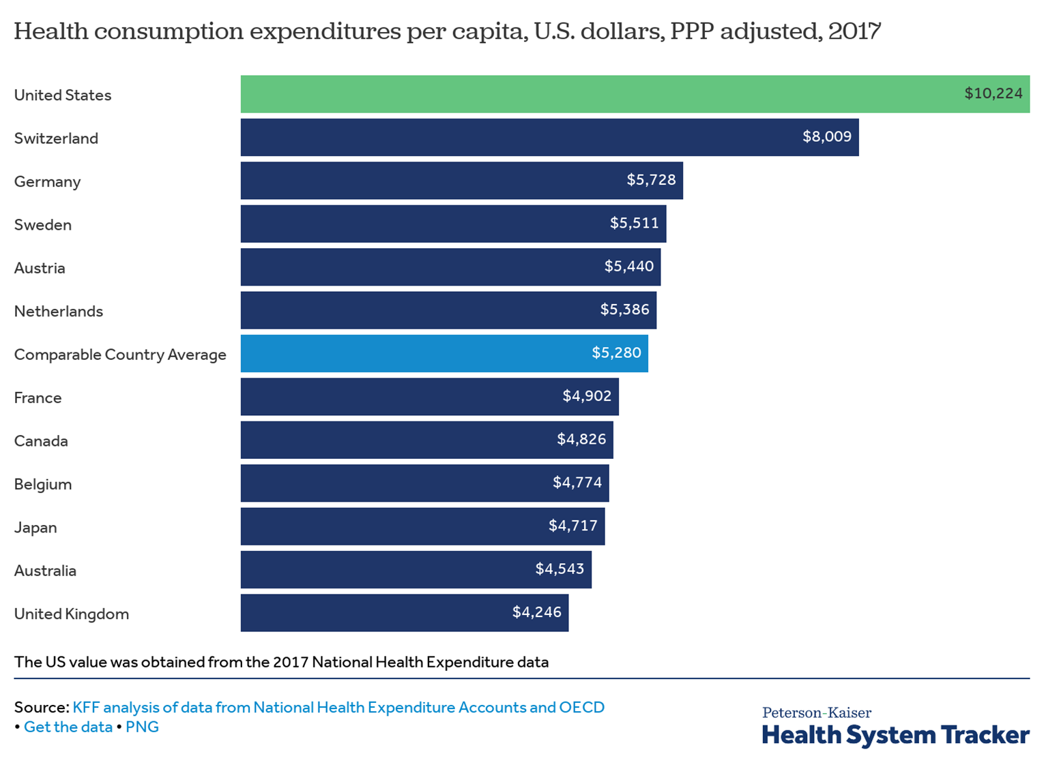
Some basic facts about US health care today

Slide 26
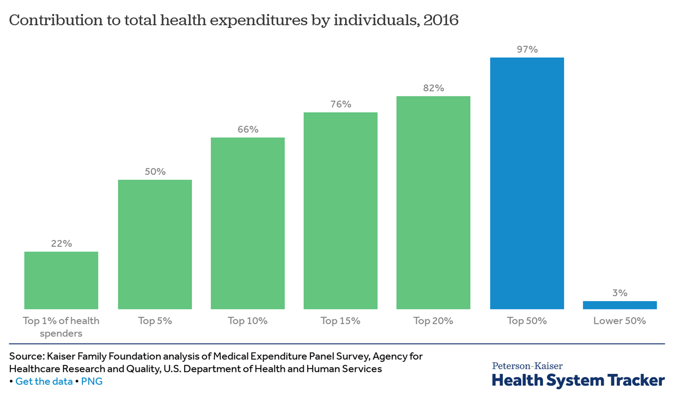

Slide 27
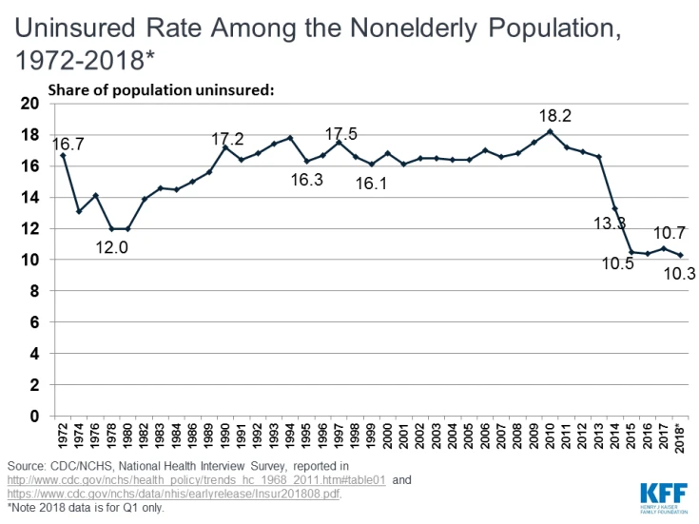

Slide 28
How people in the US get health insurance
Through their employer: 58%
Medicare (primarily for persons over age 65) ~15%
Medicaid: for (certain) lower income persons ~20% (but 40% of kids!)
ACA Marketplace

Slide 29
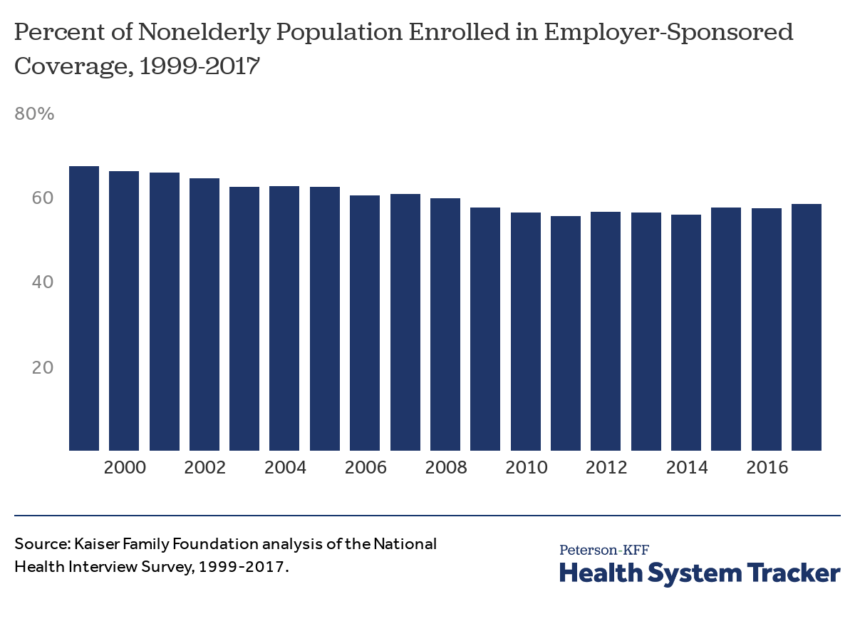

Slide 30
How did we ever end up with this system?
Most other nations rely on government provided health care (UK), government provided insurance (Canada), or a mix (Australia, France, Germany) and everyone is required to have coverage.
The US has a completely different system

Slide 31
Some background: Medical care circa 1900
No antibiotics
Life expectancy at birth: around 47 years
Most doctors did not have an undergraduate degree
Well-trained doctors could set fractures, deliver instructions on hygiene, diagnose illness. No effective treatments.
5% of infants born at hospitals

Slide 32
A leading pediatrics text: what to do for gastroenteritis

Slide 33
1901: Hospitals are a good way to GET a disease

Slide 34
The good news?
It was cheap! Average family spent $5 per year in 1900 ($147 in today’s dollars). A funeral, on the other hand, cost $132.
You didn’t need health insurance
Most families had either disability insurance through a union or fraternal society, or industrial insurance (which paid for funeral costs).
Health insurance did not exist
European countries that enacted “health insurance” were more focused on disability.
A Progressive-Era push for state level coverage failed – it had no supporters.

Slide 35
No demand, but no supply, either
Insurance companies at the time viewed health as “uninsurable”
“To collect on a life insurance policy, the insured must be dead. To collect on an accident insurance policy, the insured must have had an accident. To collect on a health insurance policy, the insured must have a policy.”
The loss wasn’t measurable
They worried that they couldn’t distinguish between sick people and healthy people

Slide 36
Adverse selection
Problem of asymmetric information
One party to a transaction has more information than the other party.
It creates inefficiency and can lead to market failure

Slide 37
Example – homeowner’s insurance
Suppose insurance company wants to provide fire insurance to 100 homeowners, each with a house worth $200,000.
Firm calculates that among these 100 homes, 80 are low risk, with a 1% chance of catching fire in a year.
Among these homes, what is the amount of money the insurance company can expect to pay out in a year?

Slide 38
Example – homeowner’s insurance
Suppose insurance company wants to provide fire insurance to 100 homeowners, each with a house worth $200,000.
Firm calculates that among these 100 homes, 80 are low risk, with a 1% chance of catching fire in a year. On average, 0.01 x 80 homes would burn in a year = .8
Among these homes, what is the amount of money the insurance company can expect to pay out in a year?
Expected loss = probability of loss x amount paid in the event of loss
= .01 x $200,000
= $2,000

Slide 39
Example – homeowner’s insurance
The remaining 20 homes have faulty wiring and are high risk, with a 20% chance of catching fire. On average, how many of these homes would burn in a year?
Among these homes, what is the amount of money the insurance company can expect to pay out in a year?
Expected loss = __________

Slide 40
A little insurance terminology
Actuarially fair premium is a premium = expected loss in a year.
In real markets, premiums have a fee on top of this, called a “loading fee” so that insurance companies can pay administrative costs and earn profit.
In this example, with perfect information, the insurance companies would charge the low risk homeowners $2,000 per year, and would charge the higher risk homeowners $40,000 per year.
The premiums they collect would equal the losses they paid out:
($2,000 x 80) + ($40,000 x 20) = $960,000
Note: this is just the number of houses, on average, that could be expected to burn, multiplied by the replacement cost: 4.8 x $200,000

Slide 41
How would adverse selection change this?
What if the insurance company could not distinguish between low-risk and high-risk homeowners? It would know that 4.8 homes would burn down on average and expect to pay out $960,000 in claims.
It would charge each household the average premium of $9,600.
Which households would buy this?_________
How much money would the insurance company collect?_________
How much money would the insurance company pay out?_________

Slide 42
Let’s see how this works.
I’m assigning you all a character, with a description and the probability of your character incurring minor medical costs in a year (in the US right now, about $8,000 annually) and major medical costs ($200,000).
I want you to do two things:
Calculate the expected medical costs your character faces
Make a monthly budget based on the average after-tax income for a single adult in the US (approx. $2350 per month).
Include rent, food, utilities, clothing, transportation, entertainment (and anything else you might need)
How much “leftover” money do you have?

Slide 43
What changes?

Slide 44
This starts to change, first with reforms to medical education
In 1900, there were 151 colleges
The majority of schools:
were proprietary (for-profit) and not affiliated with universities
did not require pre-medical college work
had short terms (4-6 months, 2 years)
required little or no lab work
focused on lectures instead of clinical experience
Johns Hopkins (1893) is the first school to require an undergraduate degree.

Slide 45
But over time, medical care improves
AMA form’s Council on Medical Education in 1904 to promote higher standards in medical education to match those existing in Europe
1906: develops rating system for schools. Based on length of term, premed requirements, curricula and facilities
1908: engages Abraham Flexner of Carnegie Foundation to study medical education in the U.S. and “hasten the elimination” of substandard schools. Many shut down, and new physicians are much better educated.

Slide 46
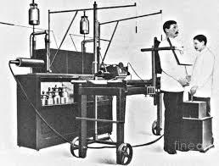
Advances in some technology
X-ray invented in 1895
Improved medical education requires laboratories
Now doctors train in hospitals
➔Medicine begins to move to hospitals

Slide 47
Public perception about hospitals changes
In 1900, popular magazines portray hospitals as something no one would go to:
“Send a sick girl out of my house? Why, I have never done such a thing in my life” (Head of household to physician suggesting that housekeeper with diphtheria be taken to hospital), Ladies Home Journal, 1900.
Ads begin appearing that tout hospital safety and the ability of patients to be cared for around-the-clock by trained nurses

Slide 48
Number of times “hospital/s” mentioned in Ladies Home Journal

Slide 49
Impact of WWI?
American physicians worked overseas with physicians trained in European medical schools
American public routinely sees stories about field hospitals on the battlefield:
Ex: performing emergency operations in sterilizing rooms under “bomb proof” conditions
Arresting hemorrhaging

Slide 50
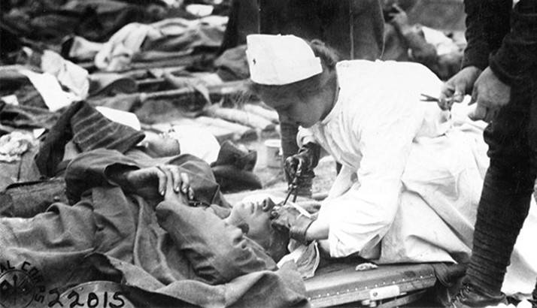

Slide 51
Even though people are going to hospitals, medical care still not great
Good doctors know about hygiene, etc. Doctors still had no real tools.
Some of the interventions may have made things worse off.
In 1900, 5% of infants are born in hospitals. By 1935, 75% of urban infants are born in hospitals.
But this transition does not improve health for mothers; maternal mortality does not decline until sulfa is available in 1937 (Thomasson & Treber 2008)

Slide 52
Even by the mid 1920s, it’s not really effective
New York Times, July 1924

Slide 53
As hospitals become more popular, medical costs rise
By 1929, average families are spending $108 annually ($1,580 in today’s dollars) ($67 if no hospitalization, $261 if hospitalized)
Average income for middle-income families was about $1,620.
Hospitals are becoming more popular – by 1930, 60-70% of infants are born in hospitals

Slide 54
Current system starts to develop
First “Blue Cross” plan developed by a hospital, NOT an insurance company
Initially, designed to get people to pay hospital bills.
Baylor U hospital was behind on its current bills and overdue on its bonded construction debt
They hired Justin Ford Kimball, who had experience creating a disability fund for Dallas teachers, and recognized that a similar approach might help people budget for hospital care
“We spend a dollar or so at a time for cosmetics and do not notice the high cost. The ribbon counter clerk can pay $0.50, $0.75 or $1 a month, yet … it would take about twenty years to set aside a large hospital bill”

Slide 55
Key features
Offered Dallas teachers a plan where they could have up to 21 days of care for $6/year
Prepaid medical care, not exactly insurance:
The plan was community rated: members paid the same rate regardless of age, gender or health status
Experience rating is different: that’s when people pay premiums based on expected risk (like auto insurance)

Slide 56
How does the Baylor plan not immediately collapse due to adverse selection?
Didn’t sell to individuals – just employers. Required a certain number of people to sign up.
At first, limited coverage to dependents
People who are working are healthy
Low administrative costs – no agents needed
Excluded some conditions altogether (mental health, pre-existing conditions)
Waiting periods for things like maternity coverage

Slide 57
The Great Depression
Hospital receipts per patient drop from $236.12 in 1929 to $59.26 in 1930. Income elastic?
Occupancy of nonprofit hospitals, 1927-1947

Slide 58
Hospitals seek revenue
Prepayment plans become very popular as hospitals seek smooth stream of revenue.
AHA organizes them under “Blue Cross” to reduce interplan/interhospital competition.
Doctors and for-profit insurance companies still reluctant to take the plunge

Slide 59
Nationalized Health Insurance Round 2: Social Security
Committee on Economic Security named to study old-age, disability, health insurance.
Government anticipated strong opposition from the AMA.
Social Security passed without health insurance, which politicians believed would jeopardize passage of original bill.

Slide 60
Physicians finally come around
During discussions of the Social Security Bill, AMA strongly denounces compulsory health insurance.
Eventually develop their own plans to stave off government plans.
1939: California Physicians service becomes first medical prepayment plan
“Blue Shield” forms in the 1940s
Perhaps because the Depression led physician incomes to plummet 47% between 1929 and 1932?
Private physicians asked for medical relief payments during Depression.

Slide 61
Important differences between Blue Cross and Blue Shield
Blue Cross pays service benefits: you pay $6 per year and get 3 weeks of care.
Physicians want to retain their ability to price discriminate.
They structure Blue Shield as an indemnity benefit: the insurance company pays the member a fixed fee, and the provider is allowed to “balance bill” for the rest.

Slide 62
Blue Cross/Blue Shield: allowed to form as nonprofits
States pass special laws called “enabling legislation” that enables them to operate as nonprofits. This allows them to operate:
On a tax-exempt basis
Not have to meet usual insurance requirements for capital reserves

Slide 63
For-profit, commercial insurance firms start paying attention
“…There are 20 stock insurance companies which are today issuing in this state Individual Medical Reimbursement, Hospitalization, and Sickness Expense Policies. About half of these have only recent gone into this field. It is no doubt the interest aroused by the non-profit associations which has induced the regular insurance companies to extend their activities in this way.”
Louis H. Pink, New York Superintendent of Insurance, 1939

Slide 65
1940s: The Perfect Storm
In 1940, 9% of the population is covered by private health insurance.
By 1953, 63% of the population is covered by health insurance.
What happened?
Medical miracles like sulfa and penicillin
A War

Slide 66
Medical Miracles
Sulfa, December, 1936
Penicillin,
August, 1941

Slide 67
WWII
Under 1942 Stabilization Act, wage increases limited, but firms could offer fringe benefits.
1943 tax ruling stated that health insurance benefits may be exempt from employee income.
1949 NLRB ruling allowed unions to negotiate for health insurance benefits in addition to wages.

Slide 68
Tax policy and health insurance development
A provision in the US tax code makes it so that when an employer pays for part (or all of) an employee’s health insurance premium, the employer contribution is exempt from employee taxable income.
This “tax subsidy” is associated with a sizeable revenue loss to government, AND causes a distortion in employee compensation.
Would you rather get $1 paid towards your health insurance, or get ($1-t) in wages (where t is an employee’s marginal tax rate) that you can then use to pay for your health insurance (or whatever else)
Thomasson (2003) suggests that these tax changes led to increases in both probability of purchasing insurance and the amount purchased

Slide 69
What factors may have played key roles in market development?
Supply side factors
# of hospitals, # of physicians
Blue Cross, Blue Shield enabling laws
# of big firms who might want to offer coverage
“price” – the loading fee
Population characteristics
Demand side factors
# of hospitals, # of physicians
# of big firms
“price”
Income
Education
Unions
Improvements in technology

Slide 70
Empirically, estimate supply & demand

Slide 71
Data
Annual, state-level data on insurance premiums from the Spectator Insurance Yearbook
Load calculated as ratio of premiums/losses
Actuarially fair insurance has load of 1.
Include state income per capita, % of state population who are union members, % illiterate (proxy for education), % black, % urban
Data on number of physicians, hospitals
Indicator variables for whether a state enacted an enabling law

Slide 72
Results

Slide 73
Results

Slide 74
Estimated coefficient on year indicator variables – captures things like technology, Federal policy, etc.

Slide 76
By 1950s, Blues started to struggle
When for-profit insurance companies entered the market, they experience rated policies.
Employers with healthier employees could get lower premiums by switching to for-profit plans
“Blue Cross and Blue Shield thus had some of their largest groups switch to coverages offered by insurance companies…Rates would have to be increased. Higher rates in themselves would discourage the continuation of favorable groups remaining with the Blues, as well as deter those considering membership.” –Eilers, 1963.
The Blues started to suffer from an adverse selection “death spiral”, as they were left with sicker policyholders who would no longer be able to afford coverage.

Slide 77
What did the Blues do?
They began to experience rate in the group market.
But in the individual market (they had started offering individual insurance in the 1940s), they could not experience rate and maintain their nonprofit status.
Commercial insurance companies even required people in the individual market to have physicals.
Blues required to allow people with group coverage to “convert” their plans to individual coverage after they retired or left employment

Slide 78
Means suggest the Blues are similar to commercial with respect to observable characteristics

Slide 81
Bottom line
Even after controlling for things like income, plan generosity, etc, Blue Cross/Blue Shield subscribers spent 24% more on medical expenditures than commercial policyholders
Suggests that Blues did suffer from adverse selection - as observable characteristics were pretty similar
By the 1990s, nearly all Blue Cross and Blue Shield plans converted to for-profit status so they could survive

Slide 82
Nationalized Health Insurance Again: Truman
Proposed single health insurance system for everyone, but would allow doctors and hospitals to be reimbursed as they have always been.
Republicans claim Truman is proposing “socialized” medicine.
Neither side interested in compromise.
AMA vehemently opposed.

Slide 83
How opposed was the AMA?
AMA levied $25 fee on each member to accumulate “war chest” to fight proposal.
Spent $1.5 million to lobby public against health insurance – most expensive lobbying effort in history.
Tried to influence public opinion
printed pamphlets filled with allegations of socialism.

Slide 84
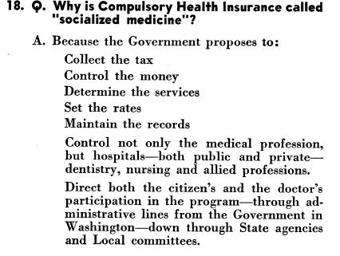
AMA Pamphlet
circulating in 1949

Slide 86
Subsequent changes
Employment-based coverage leaves out people without jobs: the unemployed and the elderly.
These were addressed in subsequent “band-aid” fixes.
These include Medicare, Medicaid
President Clinton tried to enact comprehensive health care reform but failed
The Affordable Care Act (aka Obamacare) enacted under President Obama

Slide 87
Medicare: Coverage for the elderly
Several versions proposed in the 1950s.
Finally passes in 1965.
Federal program.
Originally comprised of 2 parts: Hospital Insurance (like Blue Cross) and Supplemental Medical (like Blue Shield).
People pay in (like Social Security) with taxes on wages; get Part A for free. Part B has a premium.

Slide 88
Medicaid: coverage for certain low-income people
Passed along with Medicare in 1965, but jointly funded by Federal government and states.
Several states took years to participate (Arizona – not until the 1980s)
Federal government mandates minimum guidelines for eligibility and benefits. States can elect to be more generous.
Left a lot of people out: in some states, childless adults with $0 cannot get coverage
Affordable Care Act gives money to states to be more generous, but some states have chosen not to participate.
Indiana expanded Medicaid in 2016 – but number of uninsured Indiana residents has dropped by 41% since.

Slide 89
Affordable Care Act
As enacted, required employers over 50 employees to provide affordable coverage that met minimum requirements
Set up health care marketplaces where people could by individual insurance
Subsidies for people with incomes up to 4x federal poverty level
Required individuals to have insurance – the individual mandate. Why?
Since the ACA was put into operation in 2014, uninsured rates have fallen significantly
Future remains uncertain

Slide 90
?
?

